Slide 1
Data Structures and Algorithms INFO-3135
Iterative Sort Algorithms

Slide 2
Algorithms: Descriptions of Behaviour
Software Components must perform actions to be useful
Such behaviour is usually implemented by member functions or operations
The heart of the action is a sequence of instructions executed under certain circumstances known as an algorithm

Slide 3
Writing Efficient Algorithms

Slide 4
When writing code . . . Who cares? What do they want?
End Users
Want to maximize correctness, usability, robustness, reliability, efficiency
Developers and Maintainers
Want internal system quality to be high, for example, maintainability, reusability, and portability

Slide 5
End Users Developers and Maintainers
Correctness
Reliability
Robustness
Usability
Efficiency
Maintainability
Reusability
Portability
Adherence to requirements
Infrequent failures
How errors are handled
Ease for users
Efficient use of resources
Ease for updates, edits
Reuse of software components
Use on multiple systems

Slide 6
Efficiency . . .
Efficient use of resources means:
Reducing CPU processing time
Careful use of bytes in main memory
How?
Careful consideration of the steps we take when writing code can optimize these resources
Write efficient algorithms!
For example, two programmers could solve the same problem, but one solution might be way faster or use less memory because of coding choices

Slide 7
Examples of Efficient Coding Choices
Reduce memory usage
Instead of making copies of large arrays, use pointers or references
Choose the right data structure
Searching in an array = O(n) (linear search)
Searching in a balanced tree or hash table = O(log n) or O(1) (much faster)
Optimize loops and operations
Minimize unnecessary work inside loops
Avoid recomputing
If you calculate something multiple times, store the result
Fibonacci numbers:
Generated recursively is exponential time
Generated and saved in an array is linear time
Use built-in optimized libraries
std::sort in C++ uses a highly optimized quick sort/merge sore hybrid

Slide 8
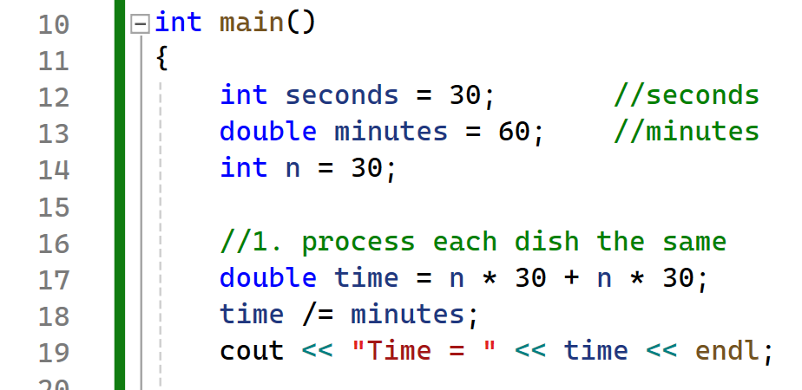
Algorithm Efficiency
How fast does a program execute? How can we measure that?
Here is an everyday example – Washing dishes by hand
Given that:
Washing a dish takes 30 seconds
Drying a dish takes 30 seconds
Calculate time:
For N dishes = N * (30 seconds for wash time + 30 seconds for dry time)
= N * 60 seconds
Written as a function:
F(x) = 30x + 30x
If there are 30 dishes to wash and dry, it will take 1800 seconds or (1800/60) = 30 minutes
What factors might affect the function?
Repetition!

Slide 9
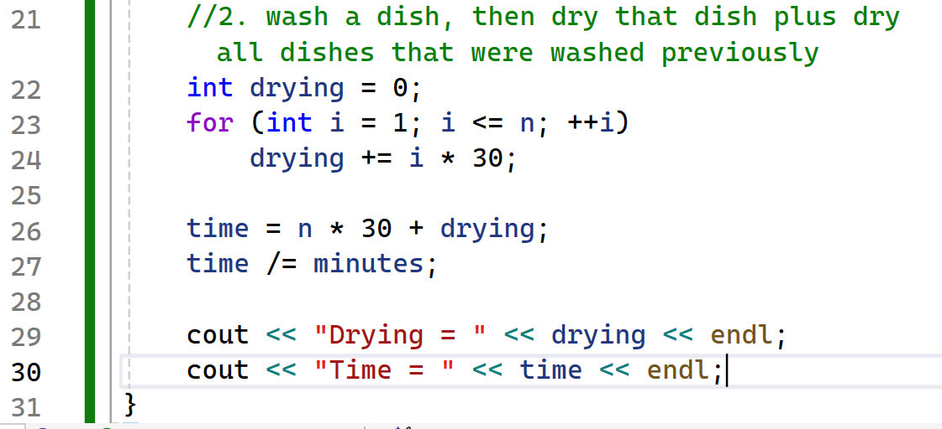
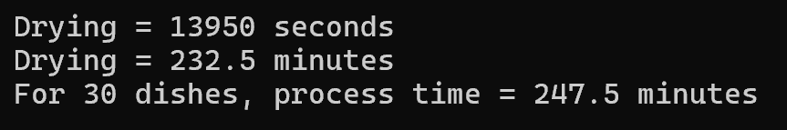
Algorithm Efficiency
Suppose we were careless while washing the dishes and splashed too much water around, wetting the previously dried dishes
Then, for every washed dish, we would have to dry that dish and all the other dishes too
Now it would take 30 seconds to dry the last dish once, 2 * 30 seconds to dry the second-to-last dish, 3 * 30 seconds to dry the third-to-last dish, etc.
Time (n dishes) = n * (30 seconds wash time) + n * sum(i * 30) //where i grows from = 1 to 30

Slide 10
Efficiency . . .
For every algorithm we want to analyze, we need to analyze:
The problem size
The processing step
When we sort a list of numbers into increasing order consider:
The number of values to be sorted
The number of comparisons
The more comparisons, the more CPU time is used
Efficiency is measured using a growth function called “Big-0 Notation” which shows the size of the problem and the value we hope to optimize
Generally, consider:
as size gets very large what happens to processing?
Any algorithm that repeats n^2 number of times takes longer

Slide 11
Big-O Notation
Good news
O(1) means an operation is done once
O(log n) means an operation is done less than n times
A data set is continually divided, reducing n, known as a divide and conquer approach
O(n) means an operation is done n times
O(n log n) means an operation is done less than n times
A data set is repeatedly divided in half, and each half is processed again
Bad news
O(n^k) means an operation is done n exponentially by k times
O(k^n) means an operation is done k exponentially by n times
O(n!) means an operation is done by n factorial times

Slide 12
Sorting
At times the efficiency of handling data can be improved by organizing the data using a set of criteria of order.
Imagine trying to find a name in a phone listing if the listing was not ordered alphabetically
A computer can still use unordered data, but it is very inefficient
A large unordered dataset can take an order of magnitude longer (that is, up to 10 times longer) than an ordered dataset to process.
How many web pages do you think are on the internet?
Billions!
How long would it take to search them if we didn’t have some form of ordering?

Slide 13
A Real-life Sorting Example
Situation:
You must organize 10,000 student papers alphabetically by last name
Using an Inefficient Algorithm like Bubble Sort (O(n²))
Take two papers at a time, compare them, swap if out of order
Repeat until everything is sorted
Using an Efficient Algorithm like Merge Sort (O(n log n))
Divide the stack into smaller groups
Sort each small group
Then merge the groups back together in order
Both methods eventually sort the papers correctly
The inefficient algorithm wastes time and energy
The efficient one saves effort and scales well as the number of files grows

Slide 14
Sorting
Sorting is the process of arranging a group of items into a defined order
Many sort algorithms have been developed
There are two categories of sort algorithms based on efficiency (i.e. measures of comparisons):
Sequential sorts (use of a pair of nested loops, n² comparisons)
Selection sort
Insertion sort
Bubble sort
Logarithmic sorts (use of recursion, nlog₂n comparisons)
Quick sort
Merge sort

Slide 15
Sort Algorithms

Slide 16
Sorting a List
When we sort a list of numbers into increasing order, consider:
The number of values to be sorted
The number of comparisons
We also consider the “sortedness” of the list
Assume we want to sort in ascending order values from 1 – 5:
Best case = 1,2,3,4,5
Worst case = 5,4,3,2,1
Average case = 3,1,5,4,2

Slide 17
Bubble Sort
Imagine our list standing on its end. The element [0] is on the bottom.
If we are sorting smallest to largest, we want the largest value at the top of the array.
As we sort, the largest value bubbles to the top
This sort uses two loops to complete its operation
This sort is less efficient than the insertion sort in that it performs the swap with every element it needs to be exchanged with

Slide 18
Bubble Sort
This algorithm works by repeatedly swapping the adjacent elements if they are in wrong order.
Each successive pass reduces the inspected part of the array or list by one element as the largest will have been placed at the top in its sorted position.
Therefore, to sort the list we start by comparing element 1 with element 2.
If they are out of order, we swap the two elements
We then move one element up in the list and repeat until we get to the top of the list
We then move our top down one and repeat the entire process
We continue until the top reference is at the bottom of the list

Slide 19
Let’s code a Bubble Sort

Slide 20
Insertion Sort
This sort starts by considering the first two elements of the array
If they are out of order, a swap takes place
Then the third element is considered and inserted into its proper place
If the third element is less than the first and second
The first two elements are shifted by one position
Second element to pos 2 and first element to pos 1
The third element is inserted at pos 0

Slide 21
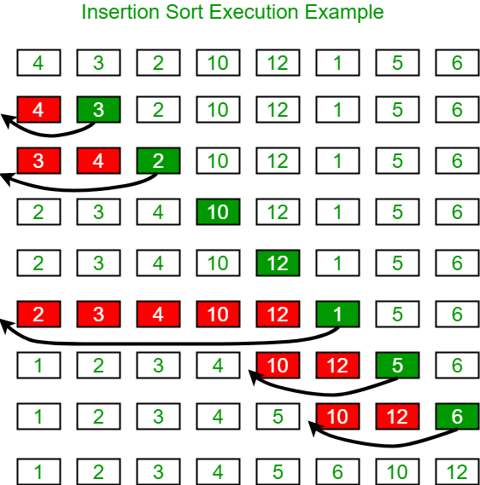
Insertion Sort
As it progresses through the data it leaves a sorted list behind.
Sorting is limited to only a fraction of the array in each iteration.
Only in the last pass is the whole array considered.
Advantage: only sorts the array if it is necessary. If the array is already sorted no substantial moves are performed

Slide 22
Insertion Sort Algorithm
Start with the result as the first element of the input.
Loop over the input until it is empty, "removing" the first remaining (leftmost) element.
Compare the removed element against the current result, starting from the highest (rightmost) element, and working left towards the lowest element.
If the removed input element is lower than the current result element, copy that value into the following element to make room for the new element below, and repeat with the next lowest result element.
Otherwise, the new element is in the correct location; save it in the cell left by copying the last examined result up, and start again from (2) with the next input element.

Slide 23
Let’s code an Insertion Sort

Slide 24
Selection Sort
Selection sort attempts to localize the exchange of elements by finding a misplaced element first and putting it in its final place.
The element with the lowest value is selected and exchanged with the element in the first position.
The next smallest element is then found and put in position 2 by swapping.
Repeat…
We move our starting point up one element for each iteration.
We keep track of our lowest found value and our position of comparison in the list.

Slide 25
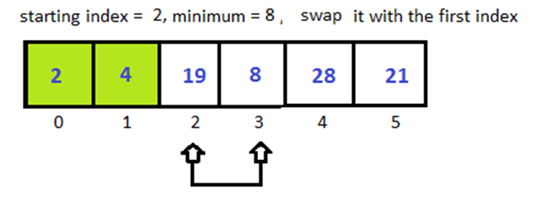
Selection sort
At each iteration find the smallest entry (the "key") in the unsorted portion of the array.
Swap the "key" with the current entry.
Pseudo Code
repeat (numOfElements - 1) times
set the first unsorted element as the minimum
for each of the unsorted elements
if element < currentMinimum
set element as new minimum
swap minimum with first unsorted position

Slide 26
Let’s code a Selection Sort

